Slide 1
Spring Framework Developer Session
The Peer Frameworks Series - .Net and Java
Chris Donnan
&
Solomon Duskis

Slide 2
Overview
600- 630
  Light Snack
630 – 700
  Introduction to Inversion of Control, Dependency Injection and other core concepts.
700 – 730
  Spring Framework - .Net Session
730 – 800
  Spring Framework – Java Session

Slide 3
About Us
Chris Donnan
  Senior Software Engineer at Finetix - servicing investment banking clients
  Contact me at : Chris.Donnan@Finetix.com
  Blog: http://blog.chrisdonnan.com
Solomon Duskis
  Solomon Duskis is a Senior Consultant at Finetix. He has worked with clients in a variety of fields including financial, insurance, publishing, and medicine. Over the last three years he has worked at clients with some level of Spring Framework deployments. His technical ramblings can be found at http://www.jroller.com/page/Solomon

Slide 4

Spring Top Level Overview and History
The history of spring. Where did Spring come from and why?
  J2EE problems
  Rod Johnson and his book
    Started in 2002/2003
    1.0 version in 2004
Where is Spring being used?
The parts of spring
  Java
  .Net

Slide 5
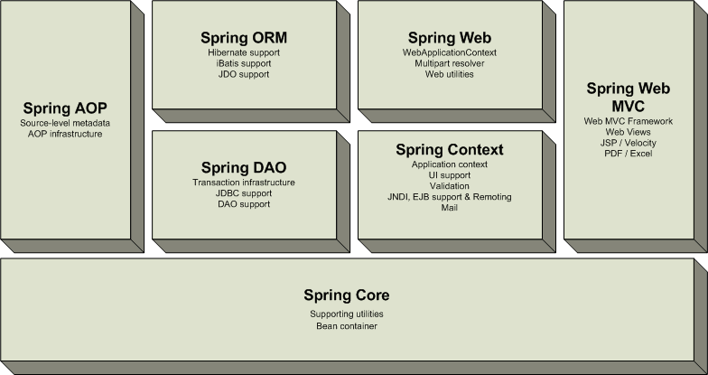
Spring for Java

Slide 6
Spring for .Net
Web
Desktop
Windows Services
3rd Party Integration
AOP
Services
Data Access
Core

Slide 7
Dependency Resolution
Plain old way
  ‘new’ your dependencies
Service Locator
  use a ‘locator’ to get instances of your dependencies
Dependency Injection
  Get your dependencies handed to you.
These all imply certain couplings…

Slide 8
Plain old dependency creation
Example:
public class Foo {
private IBar bar;
private IBaz baz;
public Foo() {
bar = new SomeBar();
baz = new SomeBaz();
}
}
Characteristics
Cons
  Your class depends upon all it’s dependencies depend on.
  Your class must know how to assemble instances of it’s dependencies and their dependencies.
  Hard to change behavior without opening code
  Hard to test as you must also test depends. Cannot use mocks.
Pros
  Easy to understand

Slide 9
Service Locator
Example:
public class Foo {
private IBar bar;
private IBaz baz;
private IServiceLocator locator;
public Foo(IServiceLocator locator_) {
locator = locator_;
bar = locator.Get(
ServiceNames.BAR
);
baz = new SomeBaz(
ServicesNames.BAZ
);
}
}
Characteristics
Cons
  Your class depends upon the service locator
  You must still get the locator to the class – either statically (yuk) or via… some sort of injection like mechanism
Pros
  Easy to understand
  Testable
  Flexible
  Extensible
  Enforces separation of interface from implementation

Slide 10
Inversion of Control
Example:
public class Foo {
private IBar bar;
private IBaz baz;
public Foo(IBar bar_, IBaz baz_) {
bar = bar_; baz = baz_;
}
}
Characteristics
Cons
  You must create dependencies to pass along
Pros
  Easy to understand
  Testable
  Flexible
  Extensible
  Enforces separation of interface from implementation
  Code is simple and clear

Slide 11
Inversion Of Control
Inversion Of Control, Dependency Injection, The Hollywood Principal etc.
In stead of instantiating concrete class references in your class, depend on an abstraction and allow your concrete dependencies to be given to you.

Slide 12
Injection Types
Setter Injection
  Pass dependencies in via mutators/ property setters
Constructor Injection
  Pass dependencies in via constructor

Slide 13
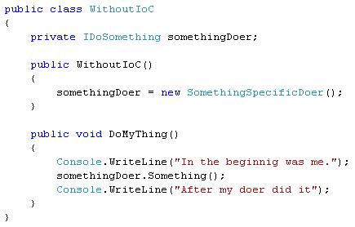
Without IoC

Slide 14
Concrete Class Dependency

Slide 15
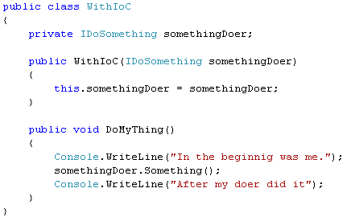
Allow dependency to be passed in

Slide 16
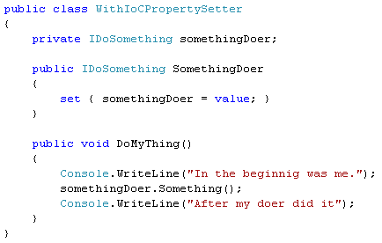
Same thing – with property setter

Slide 17
The problem with IoC by itself
To build these objects now takes assembling the whole object graph of dependencies!!! What a pain!!!

Slide 18
Containers to the rescue
The solution is a container – to manage the complex creation, lifecycle, etc.
This is where Spring comes in.
  To manage complex object assembly
    I ask for object named “Y” – the container gets any dependencies for that type, creates then or gets cached instances – gives them to the object I am trying to get and returns me that object. I then use this object as I normally would.
  To manage object lifecycles
    Singleton-ness or Non-Singleton-ness

Slide 19
Spring’s Heart
At it’s core – Spring is a framework for wiring up your entire application.

Slide 20
Object Factory
Object Factory
  The thing that creates object instances for you
  You ask the object factory for a named item – it returns an instance to you – either a singleton or a prototype.
Singleton
  There is 1 and only 1 instance
  Each time you ask the object factory for one – you get the same one
Prototype
  This is a ‘non-singleton’
  Each time you ask the object factory for one – you get a new one

Slide 21
Object factory as a Service Locator
Ideally – you could use Spring to ask for an object at the ‘top level’ of your application – and it would give you back an entire object graph of fully baked objects. That said – this is not always feasable.
You can use Spring as a service locator – or as an implementation detail of your service locator. Service locator is a great alternative to IoC – especially when things like ‘UI designers’ ‘New’ your objects in for you. Depending on how you do this – you could be more or less tied to spring (that is not great). In the past – I have tried to make spring an implementation detail – and hide it behind my own abstraction for locator.

Slide 22
Why IoC with a Container
Support programming best practices:
  Separation of interface from implementation
    Allows you to substitute implementation
  Code is smaller and cleaner – program your intent – not how to create your dependencies and their dependencies etc.
  The Dependency Inversion Principle (DIP)
    Depend upon Abstractions. Do not depend upon concretions.
  The Open Closed Principle (OCP)
    A module should be open for extension but closed for modification. Of all the principles of object oriented design, this is the most important. It originated from the work of Bertrand Meyer . It means simply this: We should write our mod-ules so that they can be extended, without requiring them to be modified. In other words, we want to be able to change what the modules do, without changing the source code of the modules.

Slide 23
Why IoC - continued
Testability
  You can substitute implementation – specifically pass in a Mock object so you only write code to test the code you are writing. You are NOT testing the code in your dependencies.
Manages assembly of complex objects for you!
Reduce coupling of code
Easy reconfiguration
Reusability increase due to decoupling

Slide 24
Other IoC Related Frameworks
Hivemind
Pico Container
Copeland
StructureMap
EJB 3
JBoss Seam
Object Builder in Microsoft CAB

Slide 25
Spring Framework .net
.Net presentation

Slide 26
Spring Framework – Java
Java presentation

Slide 27
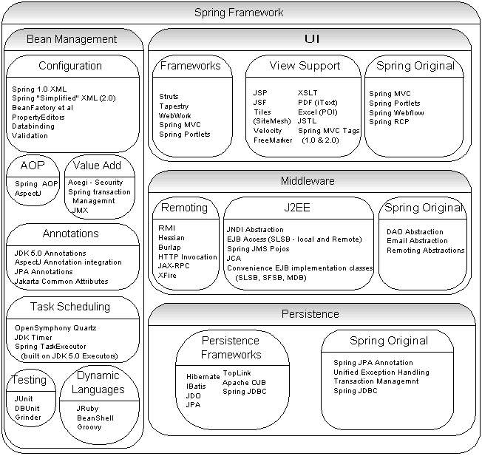
The Big Picture

Slide 28
The Peer Frameworks Series - .Net and Java
1) Spring Framework Developer Session - SpringFramework.net, SpringFramework.org
2) Test Drive Development Developer Session - NUnit, JUnit; Rhino Mocks in .net and Easy Mock in Java
3) Db4o Developer Session - Open Source Object Database in .net and Java
4) ORM Developer Session - Hibernate, NHibernate / IBatis

Slide 29
References
http://SpringFramework.org
http://SpringFramework.net
http://www.martinfowler.com/articles/injection.html

Slide 30
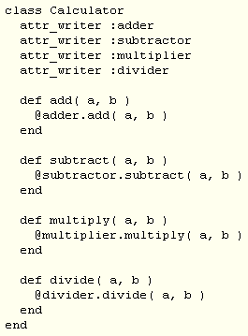
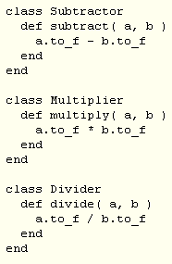
Ruby does IoC
Concrete Implementations

